Slide 1
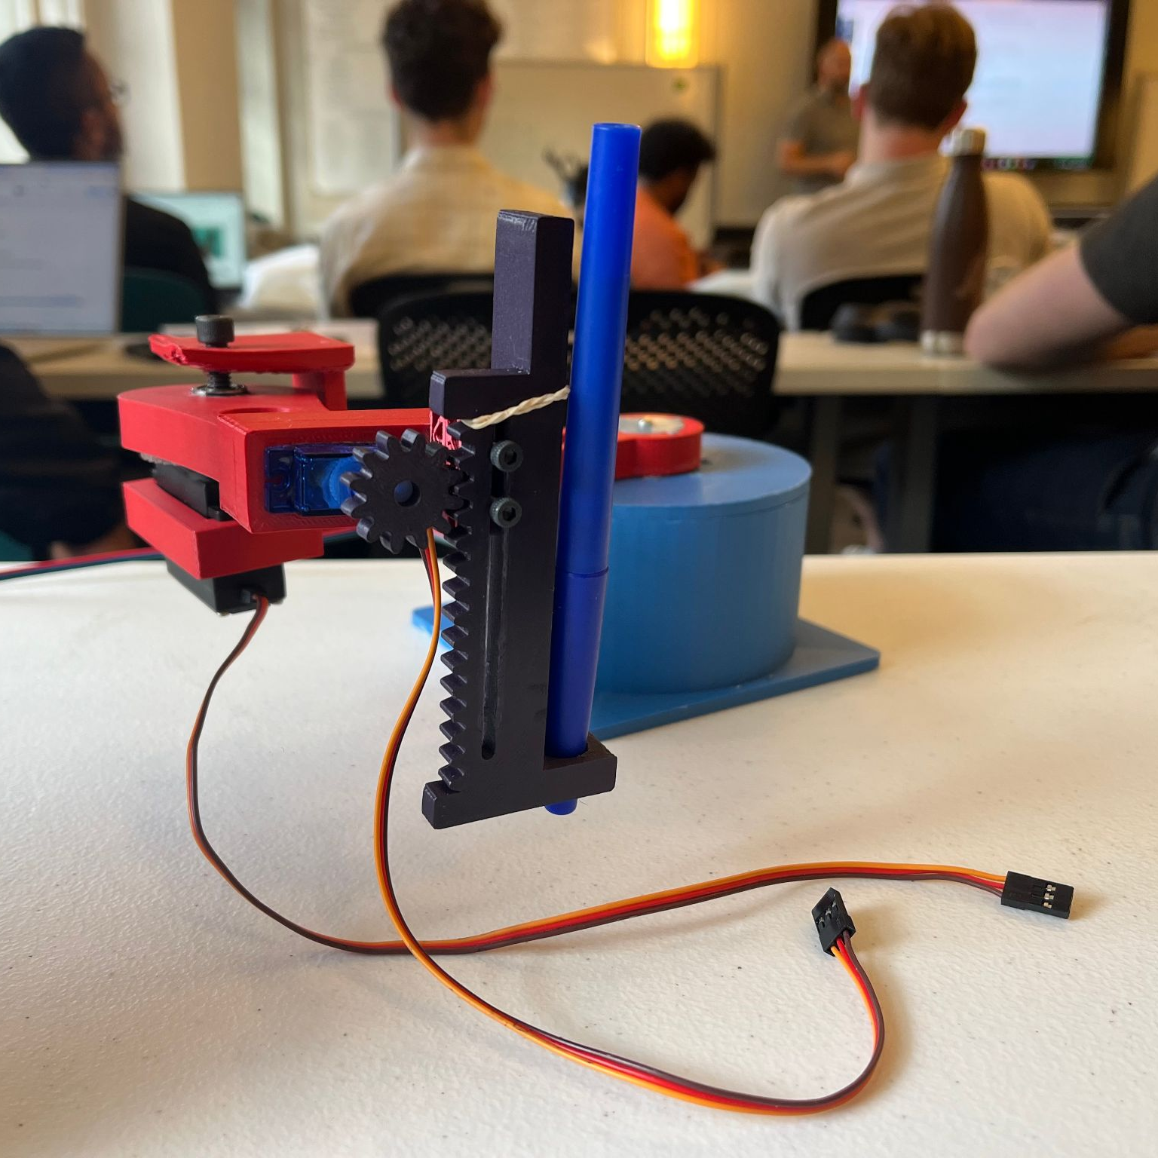
ScribbleBot
A new way to create

Slide 2

Problem
Gap in Digital-Physical Creativity:
Creators struggle to transition digital designs into physical art.
Phi Bui

Slide 3
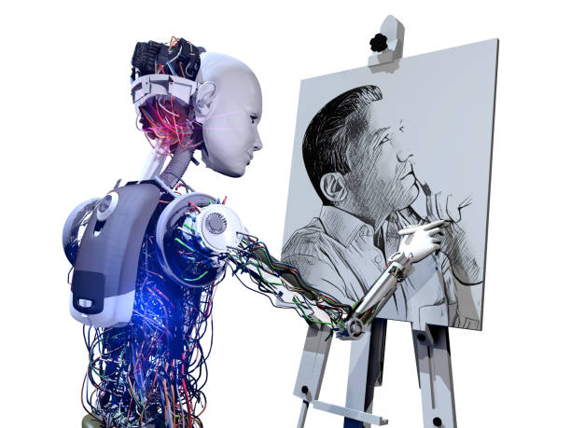
Solution
Real-Time Digital to Physical Conversion: Scribble Bot wirelessly mirrors mouse-drawn designs onto a physical canvas, ideal for artists and educators.
Easy Automation: Scribble Bot automates drawing, letting users focus on design.
Educational Impact: Scribble Bot enhances STEM and creative learning, offering interactive tech-art experiences in classrooms.
Phi Bui

Slide 4

Market Opportunity
Consumer Robotics Market Growth: Expected to grow from $8 billion to $59.5 billion by 2032, driven by demand for creative and educational robots ​(Introspective Market Research)​ (Allied Market Research).
Educational Robotics: Valued at $1.18 billion in 2023, growing through 2030 as schools increasingly adopt interactive learning tools​ (Allied Market Research).
Phi Bui

Slide 5
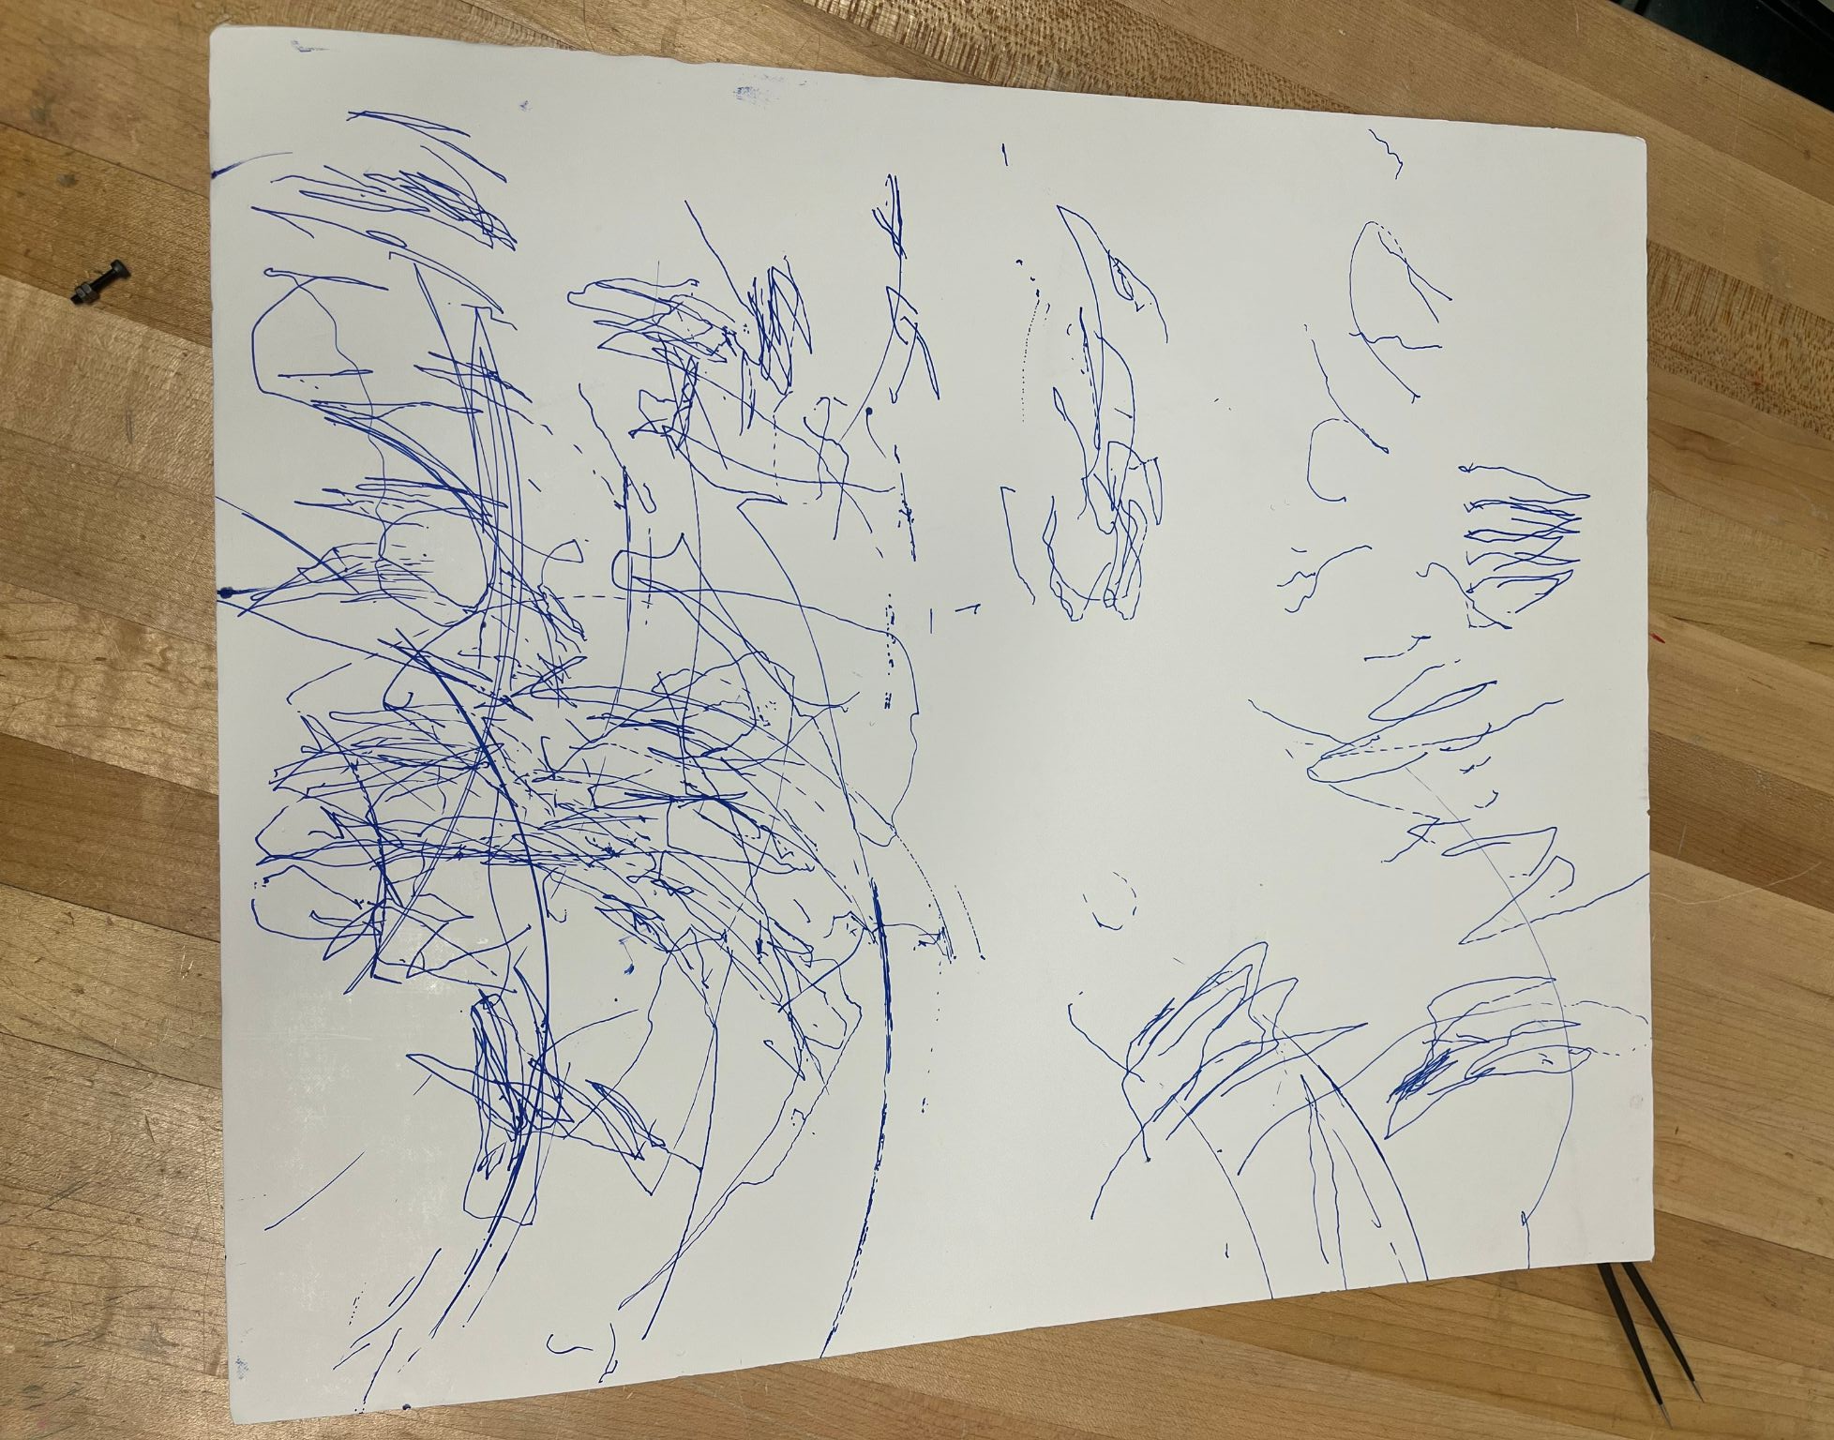
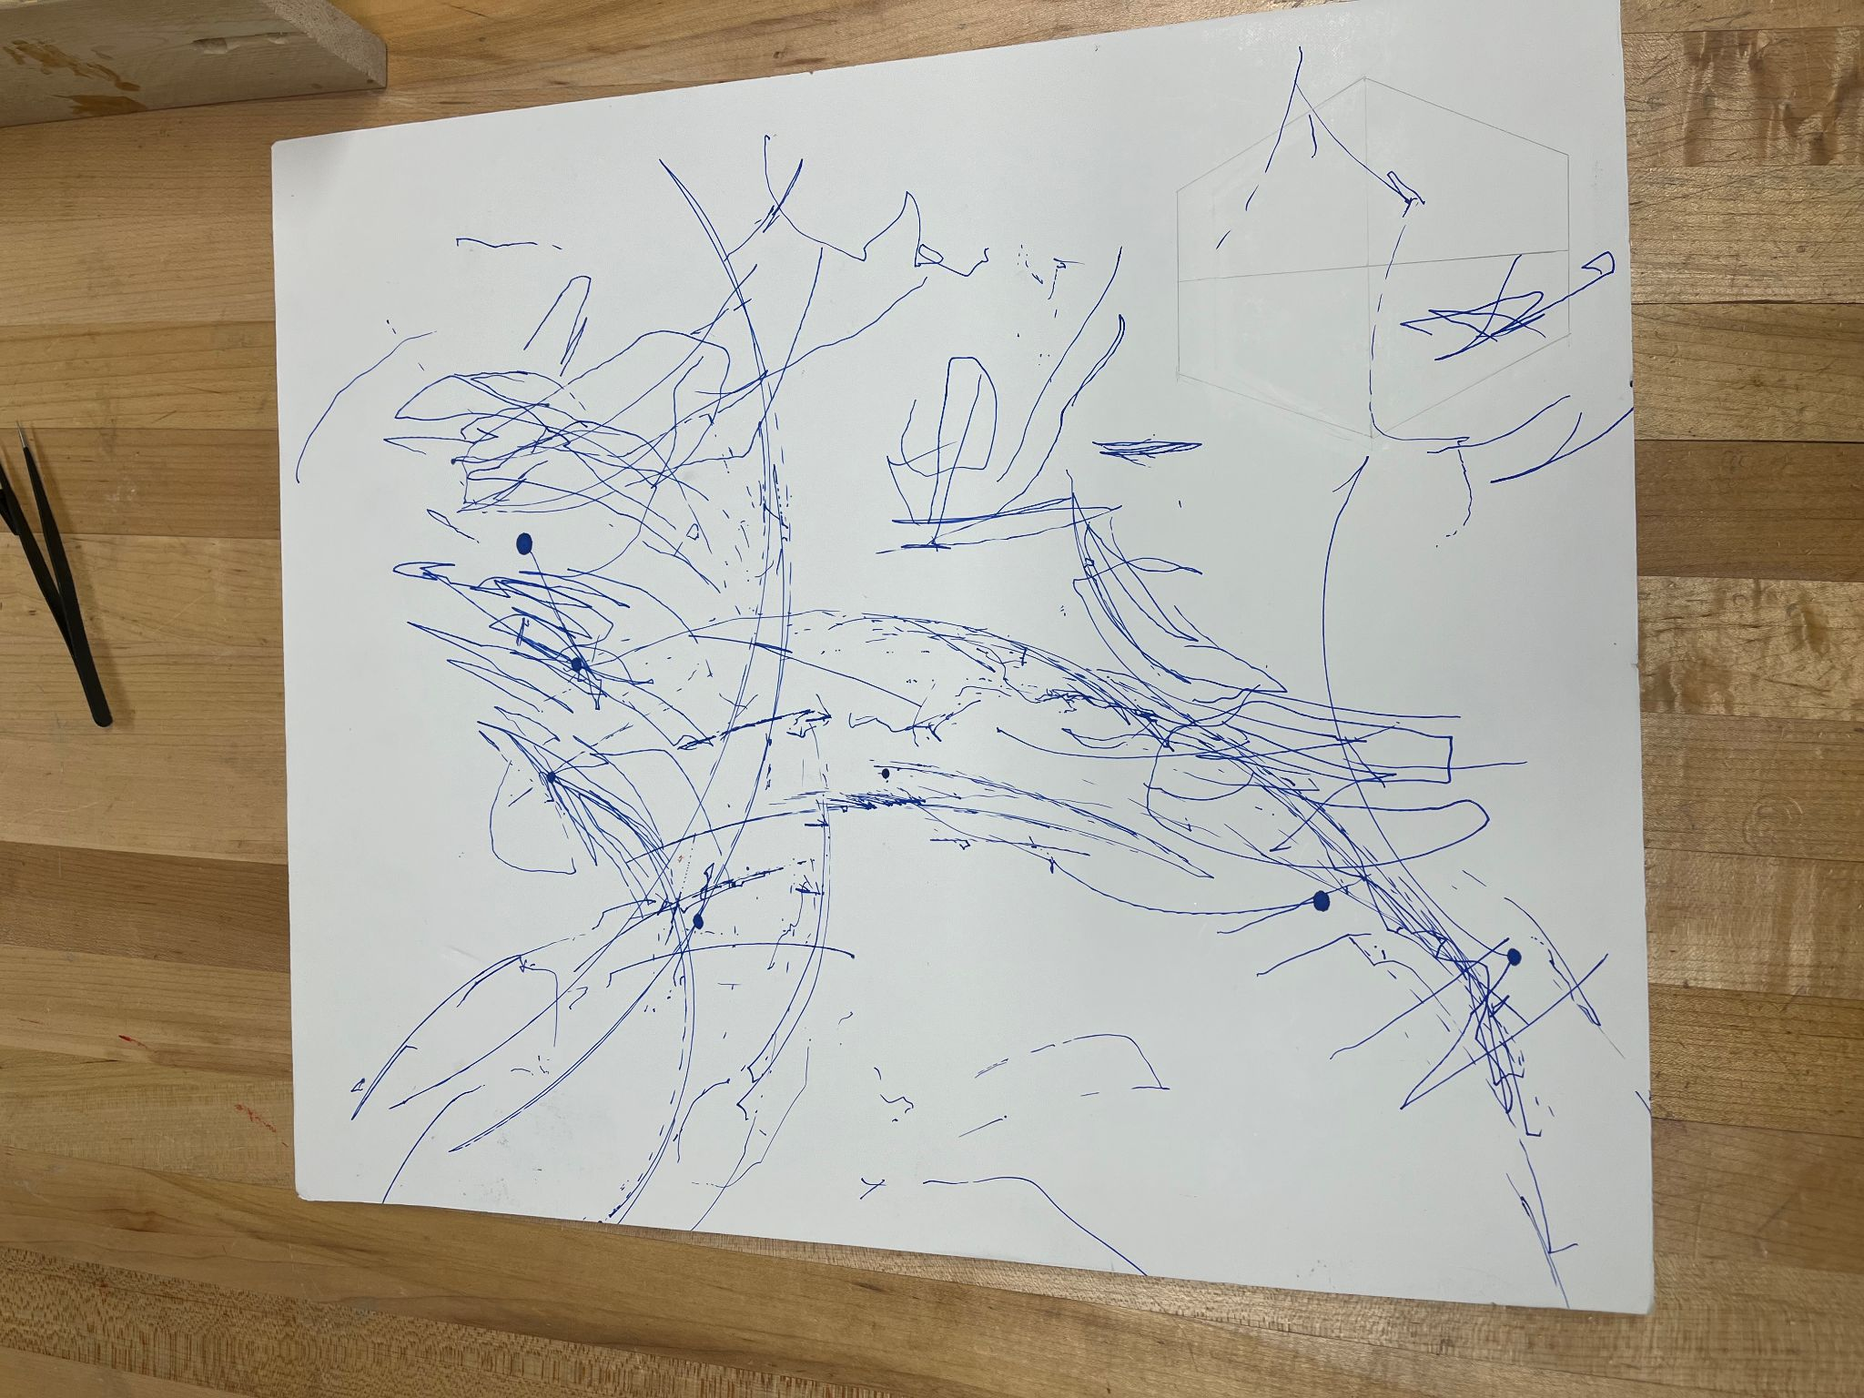
Any Robot Can Do Inverse Kinematics, Can Your’s Make Abstract Art?
Phi Bui

Slide 6
Let Scribble Bot draw you the future!

